Slide 1

Department of Computer Science & Engineering (DATA SCIENCE)
MINI PROJECT PRESENTATION
AY EVEN 2023-24
Online Voting System
PRESENTED BY:-
Ganesh Pawar
Mayank Tiwari
Neha Prajapati
Rahul Kushwaha
GUIDED BY:-
Dr. Nandini Chandra Nag

Slide 2


Contents
1.Introduction
1.1 Motivation
1.2 Problem Definition
1.3 Objectives
2. Literature Survey
2.1 Gaps identified
3.Proposed Methodology
3.1 Flowchart
3.2 Design/ block diagram
4. Implemention
5. Results and Discussion
6. Conclusion and future plan

Slide 3

1. Introduction
Online Voting System project, designed to revolutionize the way we conduct elections. In this system, we’ll use Aadhar card numbers of every user ensuring secure and fair voting. Admin access via a password provides exclusive control over vote counts and the leading candidate results. Results are delivered swiftly, offering real-time updates. This system empowers admin ensuring the integrity of the process. Get ready to innovate with us!

Slide 4

1.1- Motivation
The country has seen changes in the field of elections from ballot paper to EVM Machine. This has not only gained places in everyone's heart but has also shown the image of a revolutionizing country. The world is entering IR 4 wherein we talk of Technology and other aspects related to it. This made us think as the first time voters that, if the EVM machine could be replaced with a software how interesting it could be. Thus, we chalked a plan for online voting system. The online voting system is a groundbreaking step in advancing the largest democracy to conduct elections.

Slide 5

1.2- Problem statement
Develop a secure Python Online Voting System with authentication, error-handling, real-time results tallying, auditing, scalability and accessibility upholding the democratic principles of secure and convenient voting while ensuring integrity and confidentiality of votes cast.

Slide 6

1.3- Objectives
The objective of the "Online Voting System" project is to develop a Python-based platform that ensures secure and efficient voting processes. This system aims to use Aadhar Card Numbers for users to caste the vote and on the other hand, grant exclusive access to the admin for viewing vote counts and leading candidates to ensure swift display of results. By incorporating these features, our goal is to create a robust and transparent online voting solution, fostering trust and integrity in electoral procedures.

Slide 7
2. Literature Survey
Publication | Title of the Paper | Publication Year | Authors | Summary
INTERNATIONAL JOURNAL OF SCIENTIFIC & TECHNOLOGY RESEARCH | A Literature Survey On Sentiment Analysis Involving Social Media | MAY 2020 | Raktim Kumar Dey, Debabrata Sarddar, Indranil Sarkar, Rajesh Bose, Sandip Roy | This paper proposes unique identification for the user but one concern was that the same voters could easily vote without unique identification
International Journal of Scientific & Technology Research | A Literature Survey on Sentiment Analysis Techniques involving Social Media and Online Platforms | June 2020 | Raktim Kumar Dey, Debabrata Sarddar, Indranil Sarkar, Rajesh Bose, Sandip Roy | Here they have introduced unique identification for every user but the chief drawback was that the admin did not have any privilege from the system as anyone could access the admin mode.
Publication | Title of the Paper | Publication Year | Authors | Summary
Institute of Electrical and Electronics Engineers | Interfacing of Online and Offline Voting System with an E-Voting Website | May 2022 | Neelam Keerthi; Annam Raghuram; Ramesh Jayaraman | This paper proposes unique identification for the user but one concern was that the same voters could easily vote without unique identification
Institute of Electrical and Electronics Engineers | Smart Online Voting System | June 2021 | S Ganesh Prabhu; A Nizarahammed.; S Prabu.; S Raghul.; R.R. Thirunavukkarasu; P. Jayarajan | Here they have introduced unique identification for every user but the chief drawback was that the admin did not have any privilege from the system as anyone could access the admin mode.

Slide 8

2.1 Gaps Identified
Unrestricted voting in the previous system raised fairness concerns among voters.
Absence of password protection for admin mode allowed unauthorized access, compromising security.
Weak admin controls facilitated illegal voting, affecting the integrity of the system.
Lack of unique user identification posed risks to data accuracy, necessitating crucial improvements for a trustworthy online voting experience.

Slide 9

3.Proposed Methodology
Our Online Voting System Features Admin and Voter modes with Admin access secured by a unique password for exclusive privileges.
Admins can create elections, resume previous elections and view post-election results within their mode.
In Voter mode, users swiftly access the voting panel by entering their designated aadhar card numbers.
This system ensures secure election management, granting administrators complete control and providing students with a user-friendly voting experience.

Slide 10
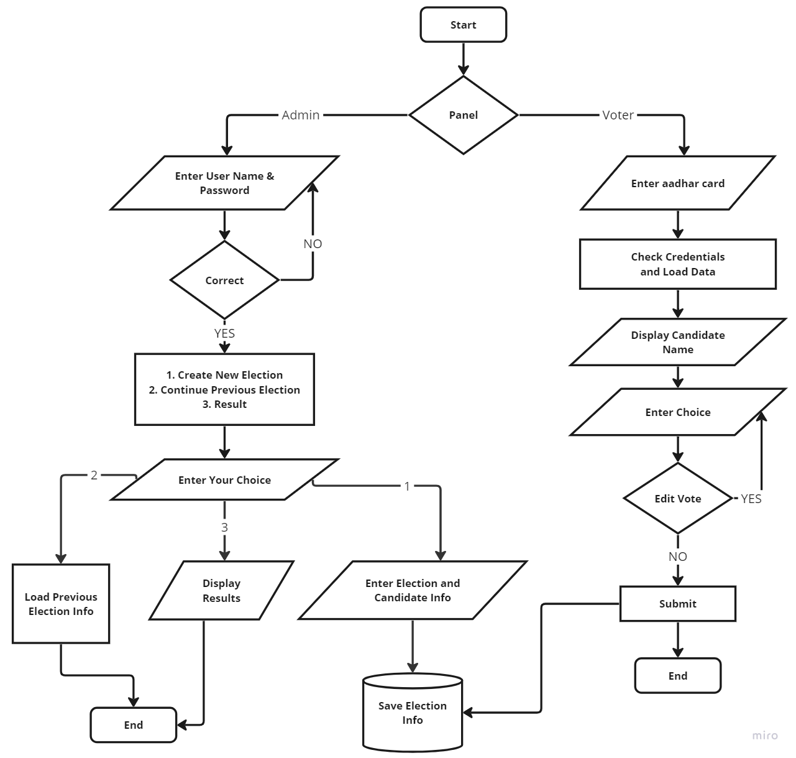
3.1 Flowchart

Slide 11
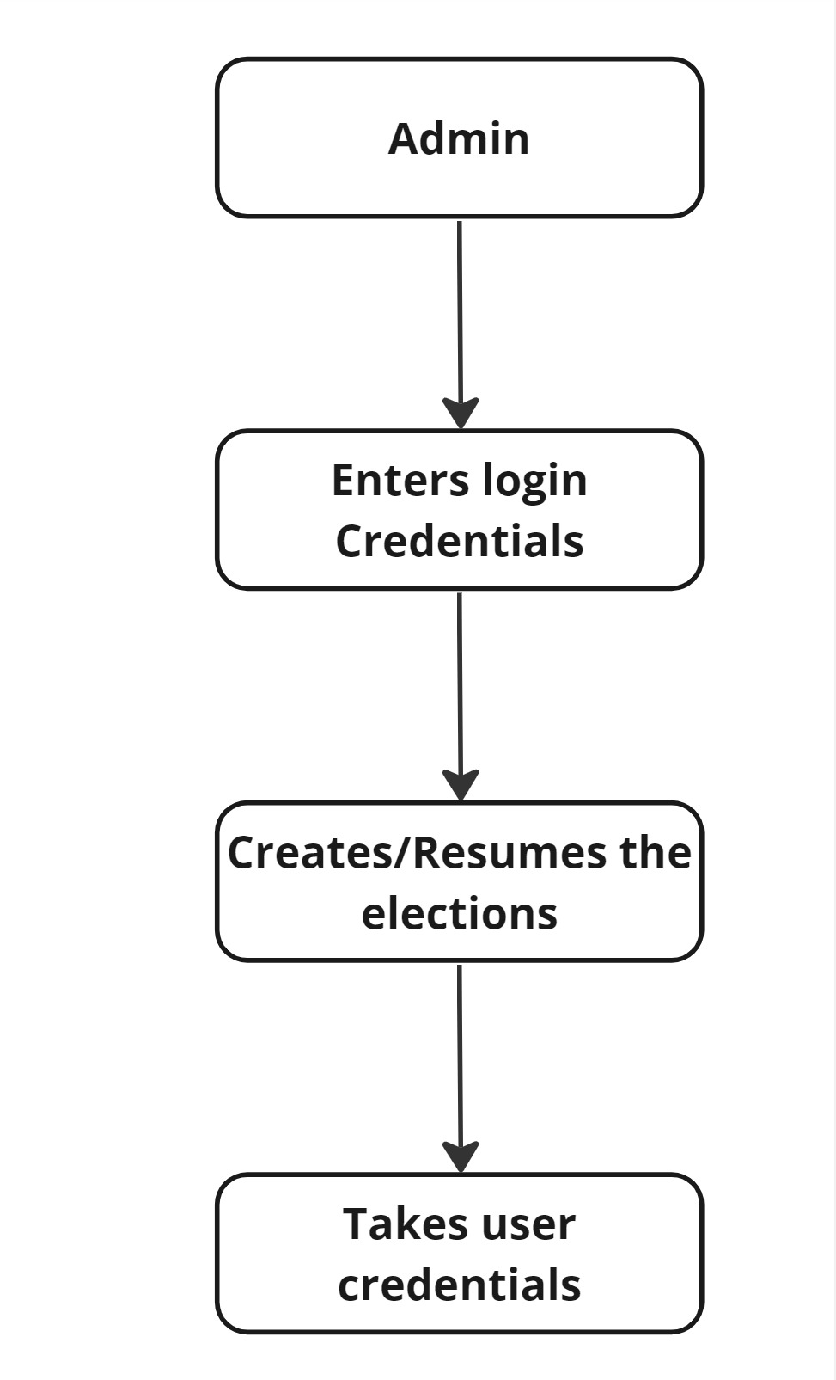
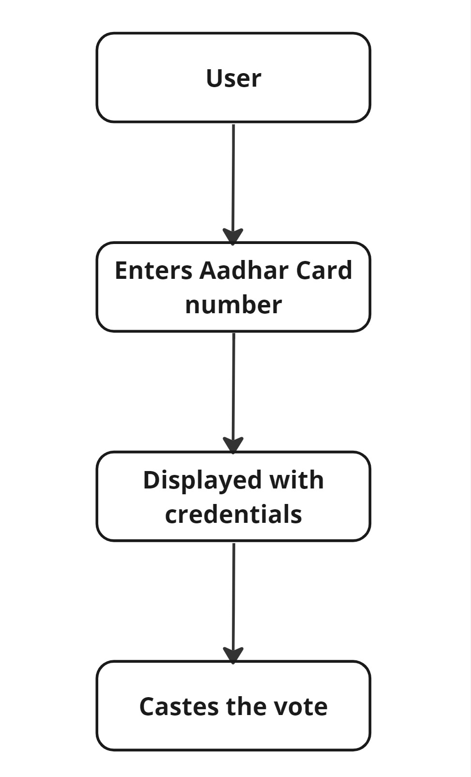
3.2 Design/ block diagram of Implementation

Slide 12

4. Implementation
Software and Tools
Python 3.11
HTML
CSS
Self Created DataSet
Hardware Requirements: (System we used)
Computer – Victus BY HP Gaming Laptops
Processor – 12th Gen Intel(R) Core(TM) i5-12450H
Ram - 16 GB
Memory Space – 256 GB

Slide 13
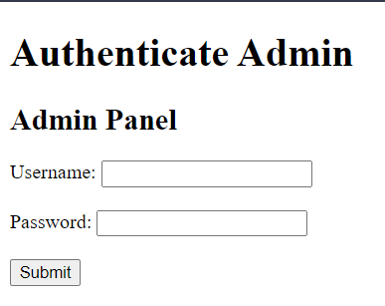
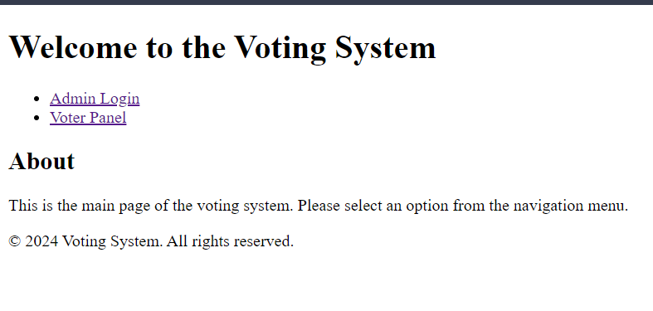
5. Result and Discussion
Figure 1: Welcome Panel
Figure 2: Admin Panel Interface where admin has to input username and password

Slide 14
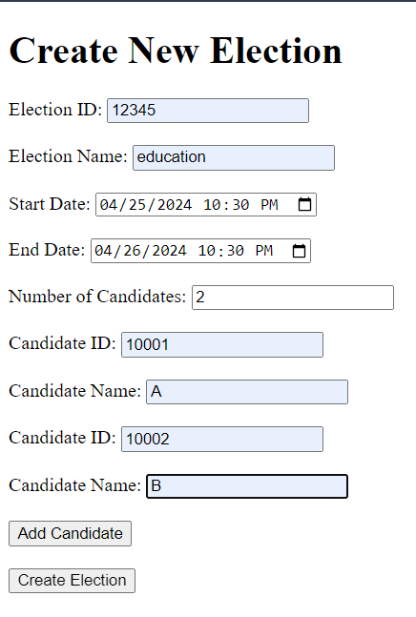
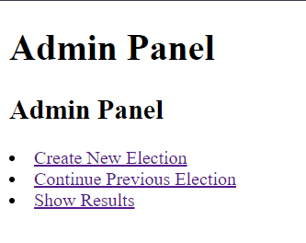
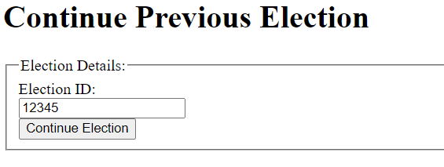
5.1. Result and Discussion
Figure 3: Interface when admin logs in the system
Figure 5: Admin panel when the admin selects to continue previous election
Figure 4: Admin panel when the admin selects to create a new election

Slide 15
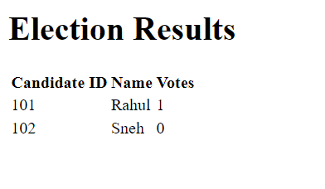
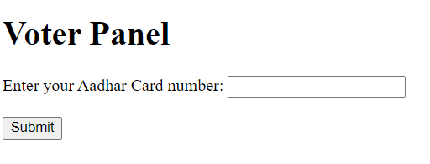
5.2. Result and Discussion
Figure 6: Admin panel when admin selects results option
Figure 7: Voter Panel

Slide 16
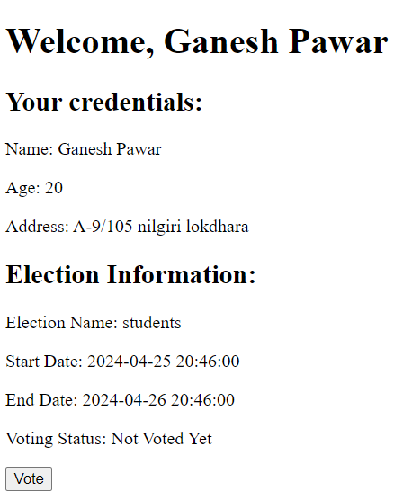
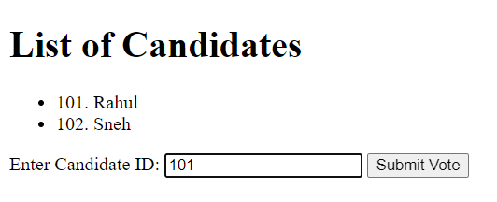
5.2. Result and Discussion
Figure 9: Voting window for voting
Figure 8: Voting panel after entering the Aadhar card number

Slide 17
6. Conclusion and future scope
Providing administrators with real-time insights into voting timelines, ensuring enhanced monitoring capabilities.
Elevating the system with seamless UI/UX integration and utilizing blockchain for tamper-proof transactions and heightened security.
Implementing robust API integration for Aadhar/Pan validation and automated ID banning algorithms.
Ensuring scalability through modular design and adoption of blockchain protocols for immutable data storage.

Slide 18
References IEEE format
[1] S. Ganesh Prabhu, A. Nizarahammed., S. Prabu., S. Raghul., R. R. Thirrunavukkarasu, and P. Jayarajan, “Smart Online Voting System,” in 2021 7th International Conference on Advanced Computing and Communication Systems (ICACCS), Mar. 2021, pp. 632–634. doi: 10.1109/ICACCS51430.2021.9441818.
[2] Ketan, S. Khare, M. Kaur, and T. Parashar, “Online Voting System,” in 2022 International Conference on Cyber Resilience (ICCR), Oct. 2022, pp. 1–7. doi: 10.1109/ICCR56254.2022.9995860.
[3] S. Sridharan, “Implementation of authenticated and secure online voting system,” in 2013 Fourth International Conference on Computing, Communications and Networking Technologies (ICCCNT), Jul. 2013, pp. 1–7. doi: 10.1109/ICCCNT.2013.6726801.

Slide 19
Thank You

